Slide 1
ROCKETRY
101
DAY 1

Slide 2
Overview
Topics We’ll Be Covering Today
Parts of a rocket
Uses for parts
Different names for these parts
Key vocab you need to know

Slide 3
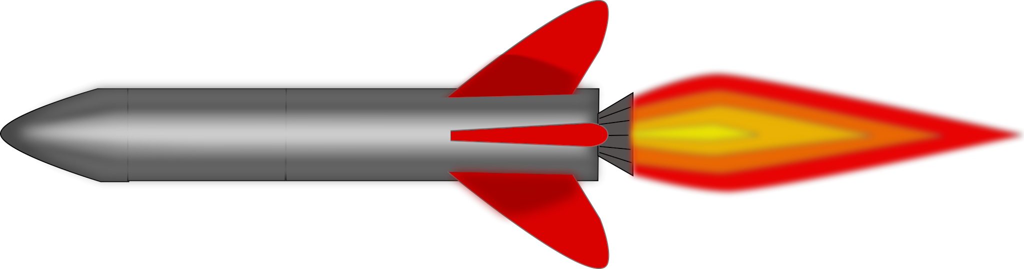
Parts of a rocket
Top portion
Nose Cone
Shock Cord
Parachute
(Ballast)

Slide 4
Parts of a Rocket
Middle Portion
Fuselage
Recovery wadding
Launch lug

Slide 5
Parts of a Rocket
Bottom Portion
Fins
Motor tube/Engine Mount
Motor

Slide 6
Parts of a rocket
Top portion
Middle Portion
Bottom Portion
Nose Cone
Shock Cord
Parachute
(Ballast)
Fuselage
Recovery wadding
Launch lug
Fins
Motor tube/Engine Mount
Motor

Slide 7
Other Key Vocab
Launch
Apogee
Launch Rails
Liquid vs Solid Engine
Ignitor
Avionics
Parachute vs Streamer

Slide 8
Launch Day Procedure

Slide 9
LAUNCH DAY
TOPICS WE WILL BE COVERING
WHAT HAPPENS DURING A LAUNCH
SAFETY
HOW WILL OUR LAUNCH LOOK

Slide 10
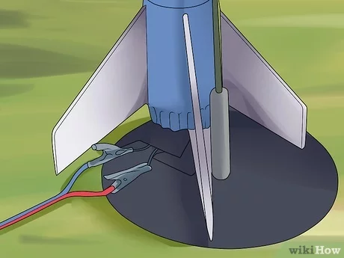
WHAT HAPPENS
SETUP
The ignitor gets pushed into the engine
Clip the alligator clips to the ignitor
Check continuity
Step back

Slide 11
WHAT HAPPENS
On the inside
The ignitor sparks within the engine
The flame burns through the fuel pushing the pressure to the outside launching the rocket up
There is a delay where nothing happens
The flame reaches the black powder after apogee
Pops the recovery system out
Rocket lands

Slide 12
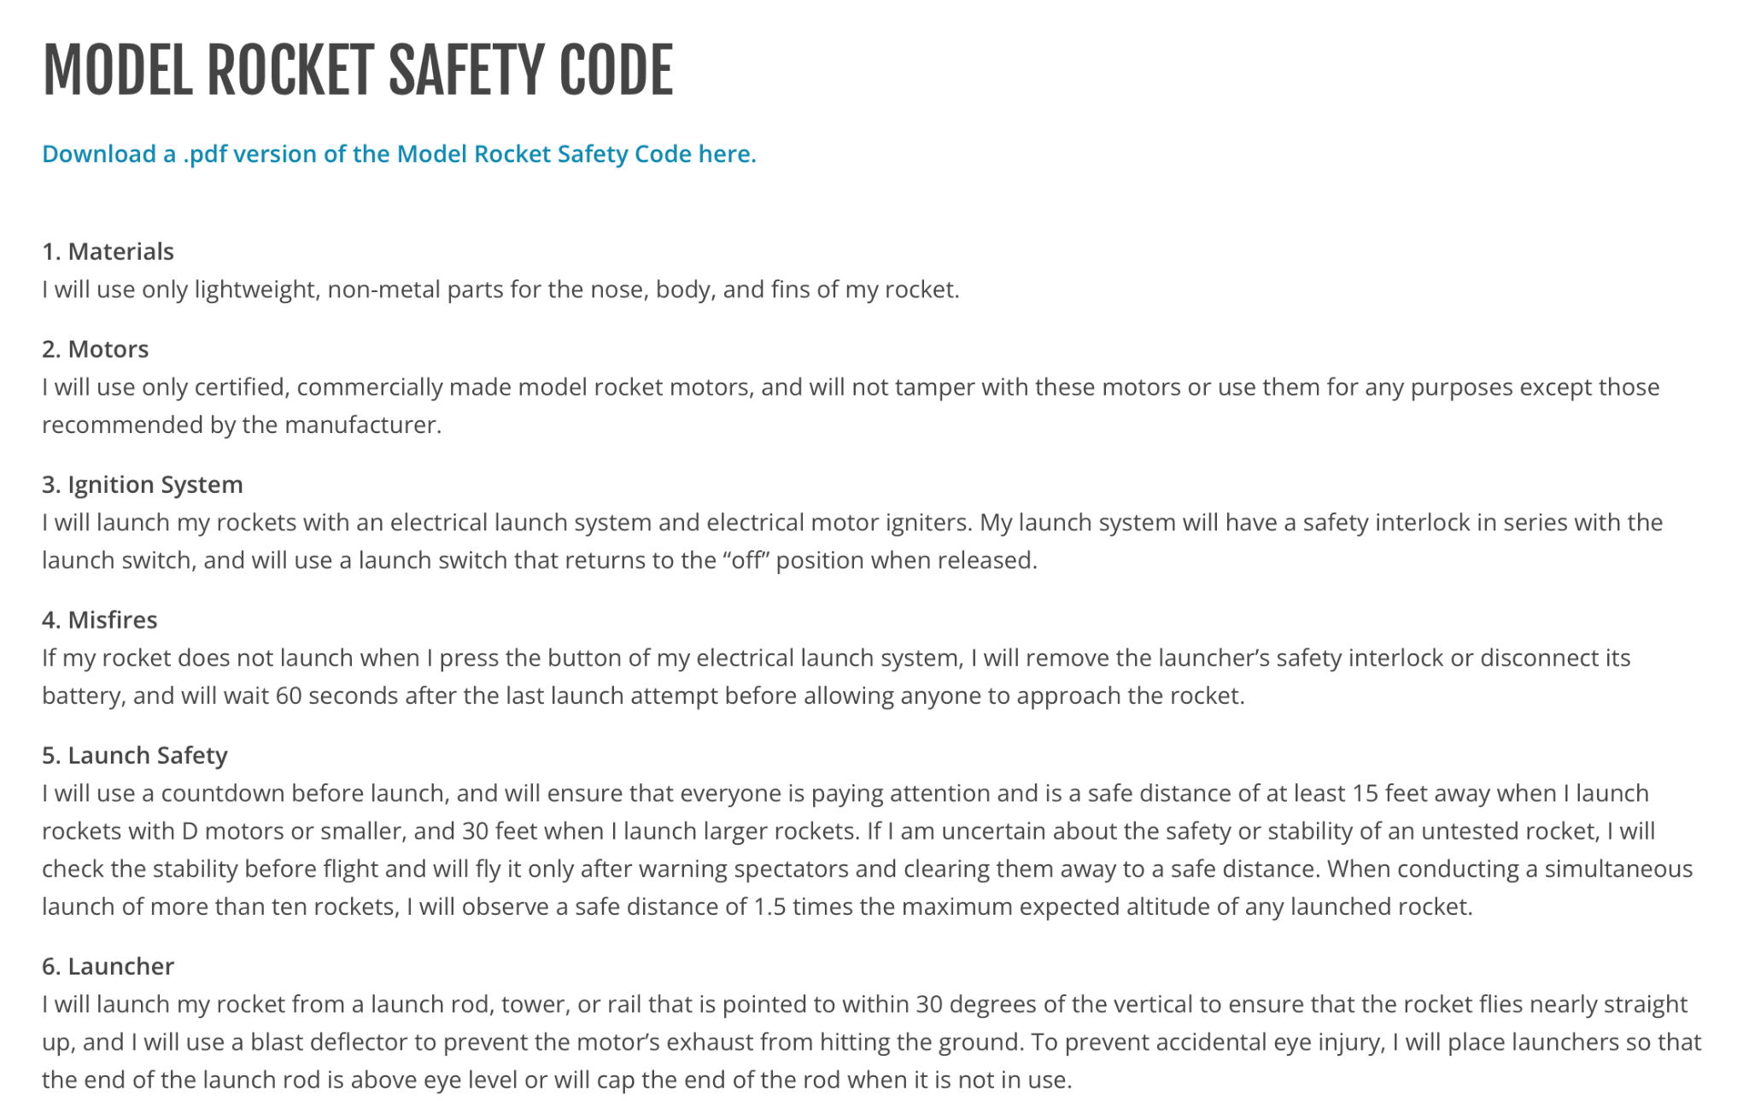
Safety

Slide 14
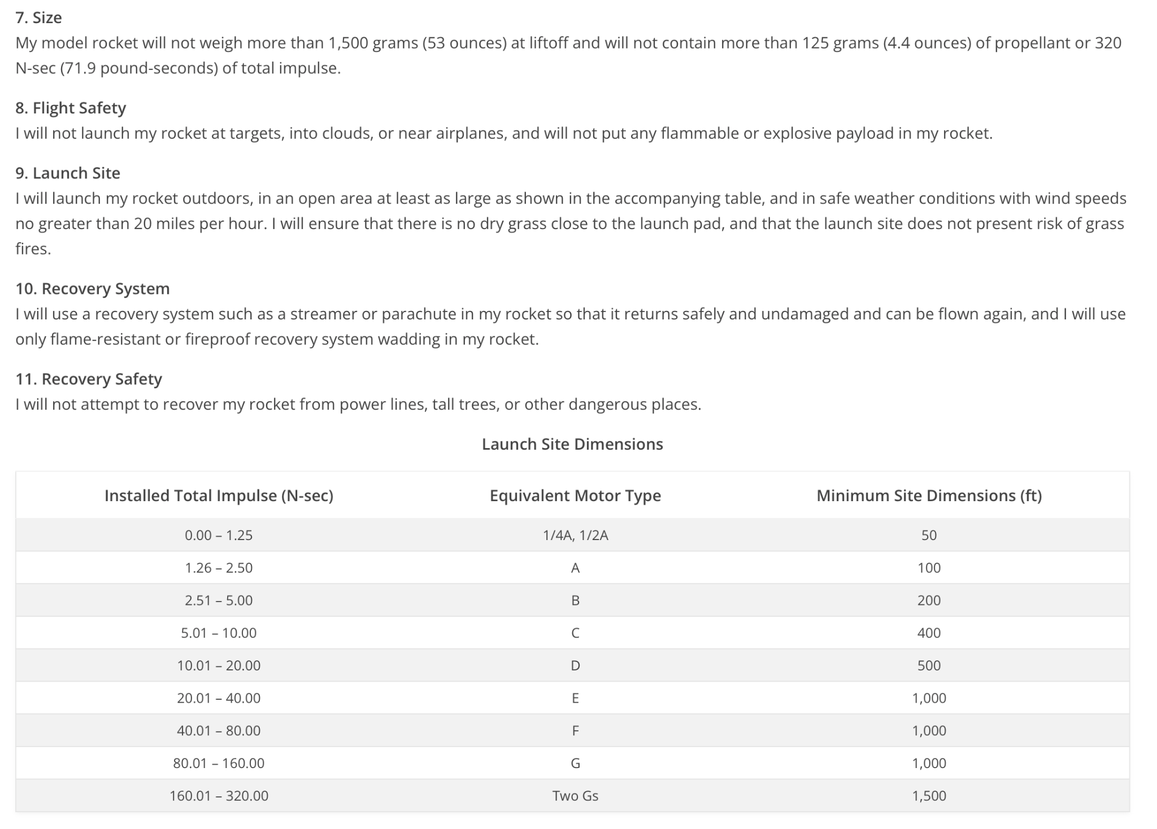
Safety

Slide 16
WHAT HAPPENS
During Our Launch
We will come down to the back field
Get our motors ready
Four launchers at a time
I will help you set up your rocket
Launch
Recover while next group gets set up

