Slide 1
The Science of Flight
HINZScience Rocketry Day III

Slide 2
What are we doing today?
lesson : Newton's Laws and the science of flight
Quiz: Bottle Rockets and History of Flight

Slide 3
Sir Isaac Newton
17th century Scientist
Credited with the laws of motion
Related motion to gravity using mathematics

Slide 4
Newton’s Three Laws of Motion

Slide 5
Newton’s First Law
“A body at rest tends to stay at rest, and a body in motion tends to stay in motion unless acted upon by an outside force.”
Explains the concept of rest vs. motion
A rocket on the pad = balanced forces (gravity vs. support)
When thrust begins, forces become unbalanced → the rocket moves upward
Spacecraft example: moves in a straight line unless gravity or another force changes its motion

Slide 6
Newton’s Second Law
“The rate of change in momentum is proportional to the force acting upon the body and in the direction of that force.”
Formula: F = m × a
Defines the relationship between force, mass, and acceleration
Example:
Cannonball vs. cannon recoil — equal and opposite forces
In rockets: burning fuel (mass expelled) = thrust (force) that accelerates rocket upward
The greater the mass of fuel burned and speed of exhaust gases, the greater the thrust

Slide 7
Newton’s Third Law
“For every action, there is an equal and opposite reaction.”
The fundamental law of rocket propulsion
Action: gases expelled backward from the engine
Reaction: rocket moves forward
Key principle behind all flight — from fireworks to the Space Shuttle

Slide 8
Newton’s Laws Overview
1st Law: A rocket stays still until thrust unbalances the forces
2nd Law: Thrust depends on how much fuel (mass) and how fast it’s burned
3rd Law: The expelled gases push the rocket upward with equal force

Slide 9
Rocket Aerodynamics

Slide 10
Stability
Stability is critical — rockets behave like arrows:
Center of Gravity (CG): point where mass is balanced
Center of Pressure (CP): point where aerodynamic forces act
For stability, CG must be ahead of CP
At least one caliper (diameter of rocket)
Improper balance = unstable, tumbling flight

Slide 11
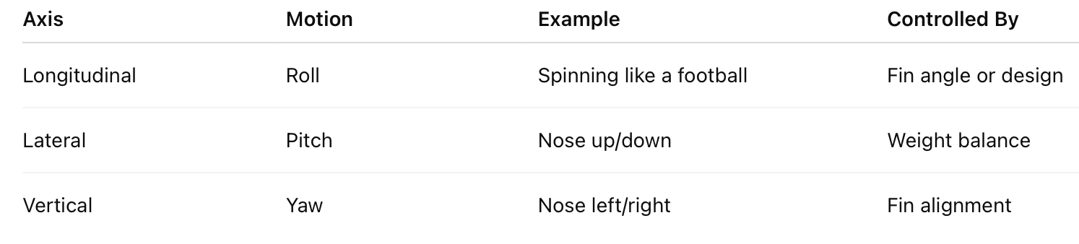

Slide 12
Axes of Motion
Longitudinal Axis: roll (spinning like a bullet)
Lateral Axis: pitch (nose up/down)
Vertical Axis: yaw (nose moves side to side)
Rocket stability depends on control around these axes

Slide 13
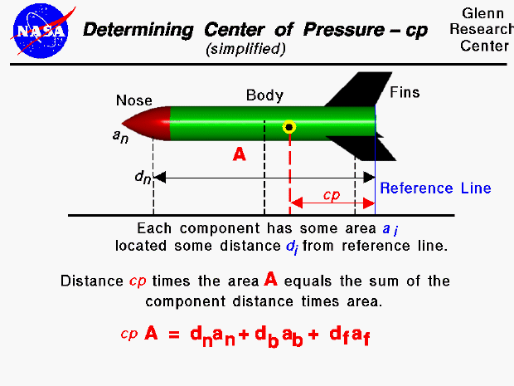
How to find Center of Pressure
We will eventually use a computer Program to find this.

Slide 14
How to find the right Center of Gravity
2 Methods:
Balance Test
Indicate where ideal center of gravity is
Balance on finger to find current center of gravity
Adjust weight in nose cone to move CG to ideal spot
String Test
Attach string at rocket’s CG
Swing in a circle — if nose points forward steadily, rocket is stable
If it wobbles or tumbles, adjust weight or fin size/placement

Slide 15
Weekly Overview

Slide 16
What now?
Instructions on Building

Slide 17
Bottle Rocket Launch Current Standings
Period | Overall | YDS | 20 Oz | YDS | 1L | YDS | 2L | YDS | Neg. | YDS
2 | Brown | 50 | Brown | 50 | Kramer | 13 | Weeks | 25 | - | -
3 | Jackson | 50 | Jackson | 50 | - | - | - | - | - | -
4 | Sierra | 32 | Sierra | 32 | Coapland | 16 | - | - | Coapland | -11
6 | Church | 43 | Bell | 41 | - | - | Church | 43 | - | -
8 | Therres | 38 | Shultz | 12 | Therres | 38 | Tinsley | 12 | Mcduffie | -36

